Slide 1

Employee Data Analysis Using Excel
STUDENT NAME : DEEPIKA . M
REGISTER NUMBER: 312219450
DEPARTMENT ; B.COM (GENERAL) III rd Year
COLLEGE NAME : S.A.COLLEGE OF ARTS AND SCIENCE
1
Notes:
1

Slide 2

PROJECT TITLE
Employee Performance Analysis using Excel:
SCORE BASED APPROACH
2

Slide 3



AGENDA
Problem Statement
Project Overview
End Users
Our Solution and Proposition
Dataset Description
Modelling Approach
Results and Discussion
Conclusion
3/21/2024 Annual Review
3

Slide 4

PROBLEM STATEMENT
Our organization lacks a clear, data-driven understanding of employee performance, making it challenging to identify top performers, address areas needing improvement, and align individual efforts with company goals. This results in missed opportunities for enhancing productivity and fostering employee growth.
4

Slide 5

PROJECT OVERVIEW
:
This project focuses on developing a comprehensive tool to analyze performance. We will gather and evaluate detailed performance data, using advanced data visualization techniques to create clear and interactive charts and dashboards. The tool will help identify top performers, highlight areas needing improvement, and provide insights to align individual and team efforts with organizational goals. By integrating automated analytics and visual summaries, the solution aims to enhance productivity, support targeted development initiatives, and foster a more effective and motivated workforce. Ultimately, this tool will enable data-driven decision-making, driving better overall performance and contributing to the company’s long-term success.
5

Slide 6

WHO ARE THE END USERS?
Managers and Team Leaders
HR Professionals
Executives
Employees
6

Slide 7

OUR SOLUTION AND ITS VALUE PROPOSITION
Our solution provides a comprehensive analysis of employee performance through advanced data visualization and automated insights. This approach boosts productivity, identifies top performers, and targets areas for improvement, ensuring alignment with company goals. The result is a more motivated and effective workforce, driving overall organizational success.
7

Slide 8
Dataset Description
EMPLOYEE DATASET: KAGGLE
FEATURES: 26
FEATURES TAKEN: 8
FIELD NAMES: BUSINESS UNIT, FIRST NAME, GENDER CODE AND PERFORMANCE SCORE

Slide 9

THE "WOW" IN OUR SOLUTION
Aggregation: Our Excel sheet compiles comprehensive employee performance data, segmented by key metrics such as productivity, efficiency, and goal achievement.
Dynamic Dashboards: The sheet includes interactive dashboards with real-time filtering options, allowing quick comparisons and insights into individual and team performance trends.
3/21/2024 Annual Review
9

Slide 10
MODELLING
DATA COLLECTION:
Drafted the data from the edunet dataset.
FEATURE COLLECTION:
Business unit, Gender unit, First name, Performance score.
PERFORMANCE LEVEL:
Exceeds
Fully meets
Needs improvements
PIP
10

Slide 11
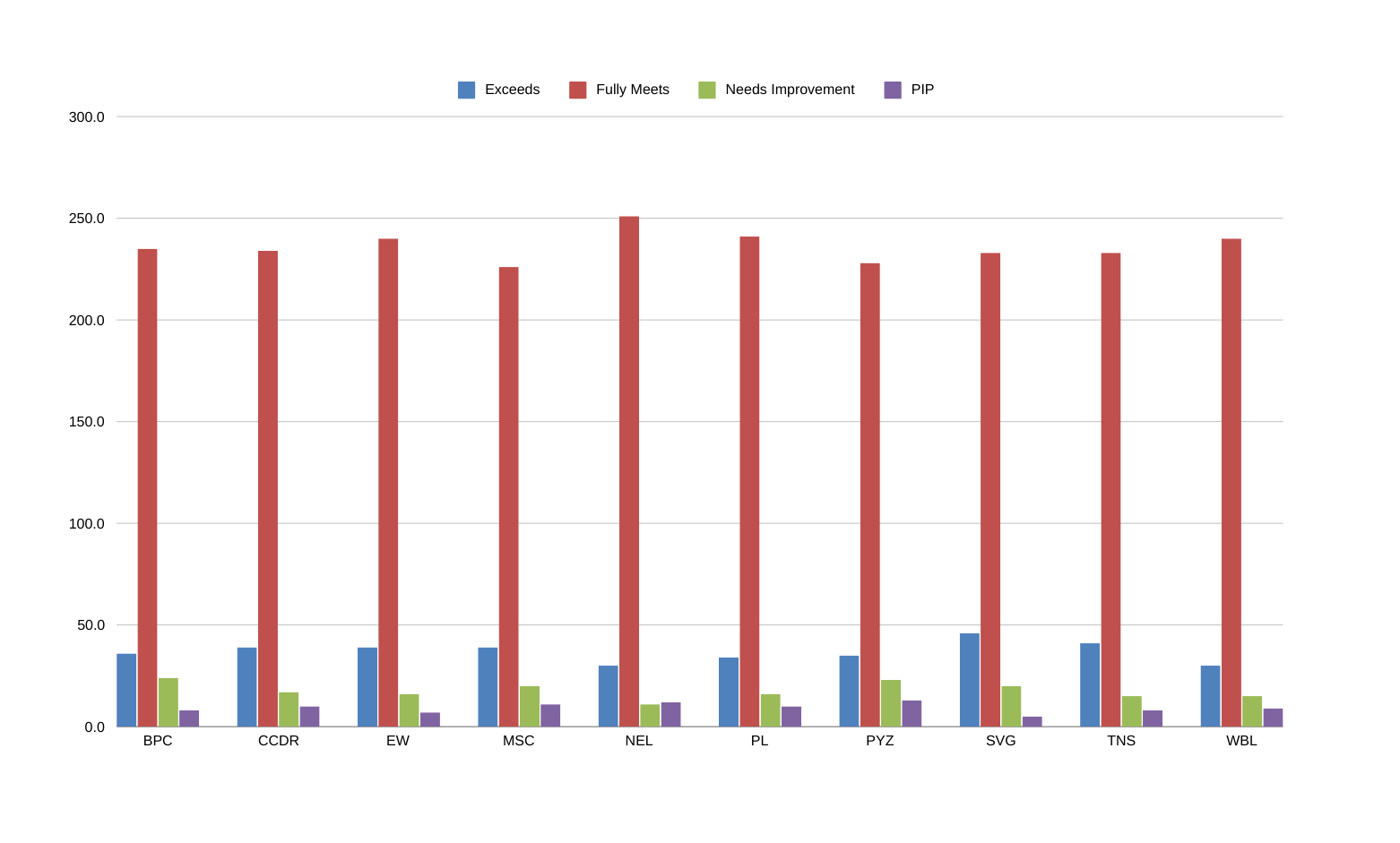
RESULTS
11

Slide 12
conclusion
Our employee performance analysis offers actionable insights to boost productivity, recognize top talent, and address improvement areas. By aligning employee growth with company goals, we foster a culture of continuous improvement, driving both individual and organizational success. Let’s leverage these insights for a stronger, more motivated workforce.

